Slide 1



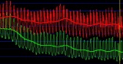

Combined Optical Coherence Tomography and Fractional Flow Reserve Assessment to Better Predict Adverse Event Outcomes in DM Patients
COMBINE (OCT–FFR) Trial
Elvin Kedhi, Balazs Berta, Tomasz Roleder, Renicus S. Hermanides, Alexander JJ. IJsselmuiden, Floris Kauer, Fernando Alfonso, Bruno Pereira, Michael Magro, Krzysztof Malinowski, Clemens von Birgelen, Javier Escaned, Cyril Camaro, Mark W Kennedy, Holger Nef, Giuseppe De Luca, Hector M. Garcia-Garcia, Wojciech Wojakowski
On behalf of COMBINE investigators
COMBINE

Slide 2
Disclosure Statement of Financial Interest
Within the past 12 months, I or my spouse/partner have had a financial interest/arrangement or affiliation with the organization(s) listed below.
Affiliation/Financial Relationship | Company
Grant/Research Support | Medtronic, Abbott Vascular
Consulting Fees/Honoraria | Medtronic, Abbott Vascular, Meril, Aortic Lab, Highlife Medical

Slide 3
Background
Fractional Flow Reserve (FFR) is widely used (Class A recommendation) to guide the revascularization strategy in the catheterization lab
Previous studies have shown that FFR-negative lesions (> 0.80) can be safely treated medically, while FFR-positive lesions (≤ 0.80) benefit from revascularisation (FAME I & II trials)
However, recent evidence has shown that in some patient subgroups such DM and/or ACS, FFR-negative lesions have worse outcomes than in patients without DM or ACS, probably due to faster atherosclerosis progression in these populations
COMBINE
Notes:
2
This is the Bulleted List slide.
To create this particular slide, click the NEW SLIDE button on your toolbar and choose the BULLETED LIST format. (Top row, second from left)
The Sub-Heading and footnote will not appear when you insert a new slide. If you need either one, copy and paste it from the sample slide.
If you choose not to use a Sub-Heading, let us know when you hand in your presentation for clean-up and we’ll adjust where the bullets begin on your master page.
Also, be sure to insert the presentation title onto the BULLETED LIST MASTER as follows:
Choose View / Master / Slide Master from your menu.
Select the text at the bottom of the slide and type in a short version of your presentation title.
Click the SLIDE VIEW button in the lower left hand part of your screen to return to the slide show. (Small white rectangle)

Slide 4
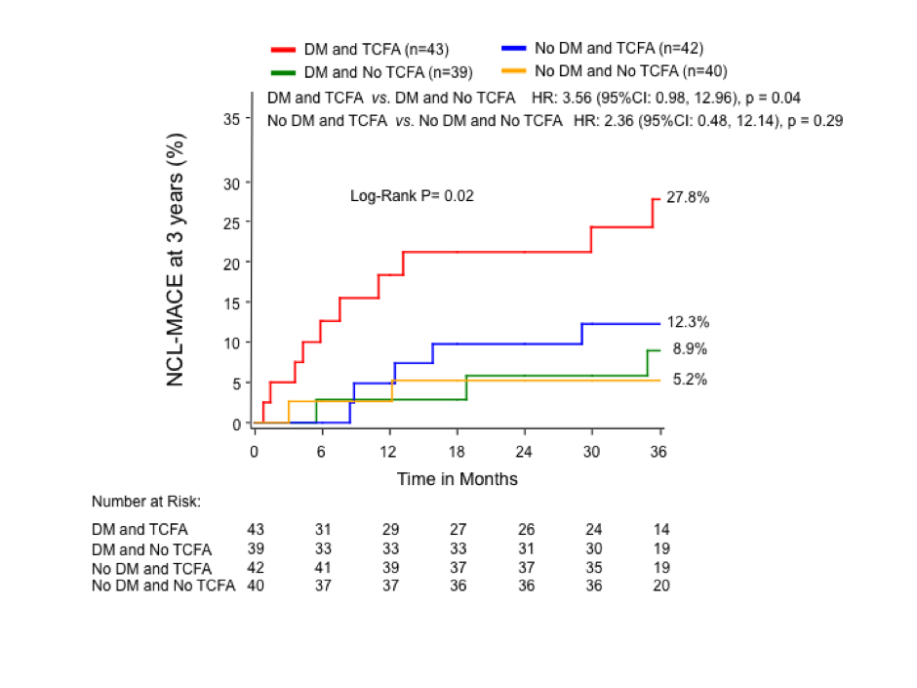
DM subgroup analysis of PROSPECT Trial
Impact of NCL and TCFA on MACE
In DM patients the majority of events originates from non-culprit lesions
DM & TCFA vs DM & NoTCFA HR MACE=3.6
NoDM & TCFA vs NoDM & NoTCFA HR =2.4
Limitations of PROSPECT: No FFR performed; IVUS resolution insufficient to detect TCFA
E. Kedhi & G.W. Stone; JACC Cardiovasc Imaging. 2017;10:451–8
COMBINE

Slide 5
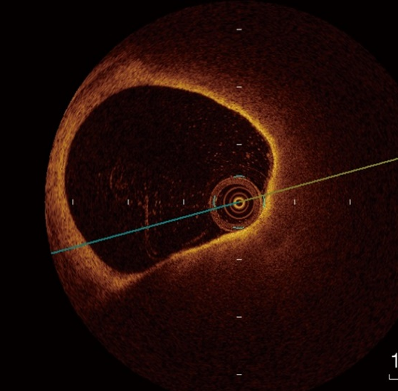
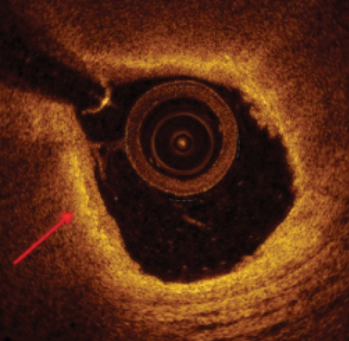
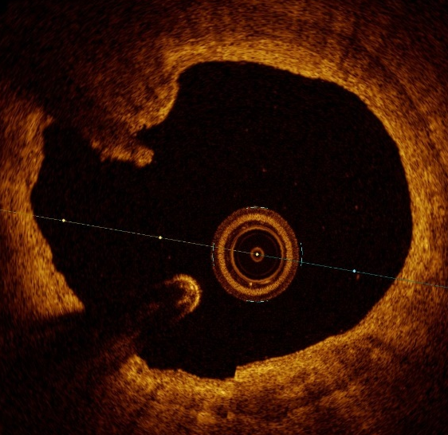
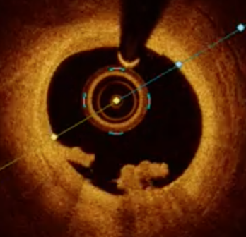
OCT imaging and plaque vulnerability
OCT imaging has an unparalleled resolution 15-20 μm OCT identifies stent components & plaque composition, particularly fibrous thin cap overlying a lipid rich sector, plaque rupture or erosion, cholesterol crystals and macrophage infiltration as well as thrombus and calcification
TCFA <65 µm
Calcified nodule
Thrombus
Lipidic plaque
Macrophage infiltration
COMBINE

Slide 6
COMBINE Hypothesis
Medically treated DM patients with angiographically intermediate but otherwise non-ischemic (FFR-negative) coronary lesions will have significantly different clinical outcomes, depending on presence or absence of plaque vulnerability features (OCT-detected TCFA), with TCFA carrying patients having the worst prognosis
The study was performed in DM patients, as they represent the patient subpopulation with the fastest atherosclerosis progression
COMBINE

Slide 7
Methods
COMBINE is a prospective, multicentric, international, double-blinded, natural history study.
We enrolled DM patients with any clinical presentation, who underwent FFR assessment in lesions with a visually estimated intermediate angiographic stenosis that fulfilled inclusion and exclusion criteria.
In patients presenting with an MI, the culprit lesions were revascularized first.
COMBINE

Slide 8
COMBINE
Inclusion Criteria
Exclusion Criteria
Age ≥ 18 years
History of DM with any indication for angiography (Stable Coronary Disease or Acute Coronary Syndrome)
At least 1 de novo lesion in a native coronary artery segment with a visually estimated diameter stenosis between ≥ 40% and ≤ 80%, defined as target lesion(s)
Target lesion(s), judged suitable for FFR and OCT imaging
TIMI flow < 3 in the Target Lesion(s)
Target Lesion Reference Diameter < 2.0 mm
Left Ventricular Ejection Fraction < 30 %
Known malignancy
Life expectancy < 2 years
Unwillingness or inability to provide informed consent
COMBINE

Slide 9
COMBINE (FFR-OCT) Design
Prospective Natural History Study
DM patients undergoing angiography for any indication with ≥ 1 lesion (non-culprit if ACS)
that has %DS ≥ 40% and ≤ 80%, defined as target lesion, that underwent FFR
FFR > 0.80
Corelab OCT lesion assessment
FFR ≤ 0.80
Group A
TCFA negative
OMT
Group B
TCFA positive
OMT
Group C
Revascularization + OMT
Primary Endpoint
Secondary Endpoint
COMBINE
Notes:
Our study the COMBINE trial is a multi-center, prospective, natural history study which combines FFR hemodynamic and OCT morphologic assessment of non-culprit lesions. The study population consists of DM patients inclusively with any clinical presentation.
After full revascularization of the culprit plaques, the (study) target intermediate lesions were evaluated by FFR. FFR-positive lesions underwent full revascularization by PCI. The FFR>0.80 lesions are treated medically. All patients had an OCT investigation to detect the TCFAs and other complicated plaques in the target lesions. (The study hypothesis is that TCFA-positive patients have a higher target-lesion related MACE rate compared to TCFA negative patients.)

Slide 10
Study Endpoints
Primary endpoint: The incidence of target lesion related MACE defined as: Cardiac death*, target vessel myocardial infarction (MI), clinically-driven target lesion revascularisation (TLR), or hospitalisation due to unstable or progressive angina** at 18 months in the FFR-negative TCFA patients (Group B) vs. FFR-negative No-TCFA patients (Group A)
Key secondary endpoint: Incidence of MACE (Cardiac Death, TV-MI, CD-TLR, or hospitalisation for unstable angina) between FFR-negative TCFA-positive (Group B) vs. Revascularized FFR-positive lesions (Group C)
* Not directly related to non-target lesion events ** Any Unstable Angina not related to non-target lesions events
COMBINE

Slide 11
Sample Size and Power Calculations
The study was powered for superiority for the primary endpoint, assuming
  A MACE rate in groups A and B of 5% and 20%, respectively;
  Equal (50% / 50%) patient distribution between groups A and B with possibility of 20% of bidirectional variation (30% / 70% or 70% / 30%);
  Group C patients not exciding 1/3 of all patients;
  7% loss to follow-up.
  Then, a total of 500 patients (334 in groups A & B) will provide 80% power to reject the null hypothesis with 5% type I error.
Per-protocol analysis is dictated from study design (patients that could not be allocated to groups A, B, or C were excluded from the analysis).
COMBINE

Slide 12
Trial Geography
Site | Country | Investigator | Initiation date | Enrollment
Isala, Zwolle | Netherlands | E. Kedhi | 2015-06-03 | 224
A. Schweitzer Ziekenhuis, Dordrecht | Netherlands | A. IJsselmuiden/F. Kauer | 2015-06-11 | 94
Hospital La Princesa, Madrid | Spain | F. Alfonso | 2016-06-02 | 73
Amphia Ziekenhuis Breda | Netherlands | A. IJsselmuiden | 2017-02-13 | 53
UC Radboudumc, Nijmegen | Netherlands | C. Camaro | 2016-08-16 | 26
INCCI, Luxembourg | Luxembourg | B. Pereira | 2015-06-29 | 17
Medisch Spectrum Twente, Enschede | Netherlands | C. von Birgelen | 2015-04-16 | 12
Tweesteden Ziekenhuis, Tilburg | Netherlands | M. Magro | 2015-08-27 | 11
Hospital Clínico San Carlos, Madrid | Spain | J. Escaned | 2016-03-31 | 10
Universitätsklinikum, Gießen | Germany | H. Nef | 2016-01-13 | 9
Beaumont Hospital, Dublin | Ireland | M. Kennedy | 2018-01-16 | 8
AL Qassimi Hospital, Sharjah | UAE | A. Al Nooryani | 2017-09-25 | 7
Uniklinik RWTH, Aachen | Germany | S. Reith | 2015-12-02 | 5
Hospital Clinica M. Domini, Catanzaro | Italy | C. Indolfi | 2016-04-18 | 1
COMBINE

Slide 13


Study Organization
Executive Committee
Elvin Kedhi
Tomasz Roleder
Alexander Ijsselmuiden
Fernando Alfonso
Clemens von Birgelen
Giuseppe De Luca
Renicus Hermanides
Hector Garcia Garcia
Wojciech Wojakowski
Study Leadership
Clinical Event Committee
P. Van der Harst,
M.J. De Boer .
W.S. Remkes
Elvin Kedhi
Sonja Postma
Balasz Berta
Mark W Kennedy
Krzysztof Malinowski
Petra Koopman
Principal Investigator
Study Coordinator Data Coordinator
Data Coordinator
Statistician
Statistician
Statistic Analysis
KCRI Krakow Poland
Sponsor
Isala Hartcentrum
Zwolle Netherlands
Data Coordinating Center
Diagram BV Zwolle Netherlands
Founding
Sint Jude Medical
Abbott
Corelab
Diagram BV Zwolle
Netherlands
COMBINE

Slide 14
Flow of
Study Patients
550 patients enrolled
3 violation of exclusion criteria
2 malignancies
1 failure to revascularize the culprit lesion
547 entered study procedure
6 had no eligible target lesion (restenosis)
6 had no FFR performed
423 had FFR > 0.80
112 FFR ≤ 0.80
3 had PCI in FFR (-)
30 had no OCT or not analyzable OCT
19 had no revascularization in FFR (+) lesions
390 had valid OCT
93 had revascularizations
292 No-TCFA
98 TCFA
1 lost to FU
1 lost to FU
1 lost to FU
291 18M FU
97 18M FU
92 18M FU
COMBINE

Slide 15
Baseline Clinical Characteristics
 | Group A No TCFA n = 292 | Group B TCFA n = 98 | Group C FFR (+) n = 93 | p Value A vs. B | p Value B vs. C
Age | 68.0 (62.0; 74.0) | 70.0 (58.7; 76.2) | 69.0 (60.5; 73.5) | 0.87 | 0.59
BMI | 29.0 (26.3; 32.3) | 28.7 (26.5; 32.7) | 28.4 (26.51; 32.0) | 0.99 | 0.90
Sex (male) | 180 (61.6%) | 65 (66.3%) | 74 (79.6%) | 0.41 | 0.04
DM Insulin | 100 (34.2%) | 35 (35.7%) | 22 (23.7%) | 0.79 | 0.07
DM Oral Antidiabetics | 240 (82.2%) | 82 (83.7%) | 81 (87.1%) | 0.74 | 0.50
Smoking status
Smoking Currently | 53 (18.7%) | 22 (22.4%) | 15 (16.5%) | 0.42 | 0.30.
Smoking Previously | 64 (31.1%) | 23 (34.8%) | 33 (44.0%) | 0.57 | 0.27
Hypercholesterolemia | 171 (58.8%) | 61 (62.2%) | 63 (68.5%) | 0.54 | 0.37
Hypertension | 214 (73.8%) | 75 (76.5%) | 67 (72.8%) | 0.59 | 0.56
Previous ACS | 97 (33.2%) | 42 (42.9%) | 42 (45.2%) | 0.08 | 0.75
Previous PCI | 103 (35.3%) | 41 (41.8%) | 43 (46.2%) | 0.24 | 0.54
Previous CABG | 8 (2.7%) | 4 (4.1%) | 1 (1.1%) | 0.51 | 0.37
Previous CVA | 20 (6.8%) | 12 (12.2%) | 5 (5.4%) | 0.09 | 0.10
SCD at presentation | 215 (73.6%) | 77 (78.6%) | 63 (67.7%) | 0.78 | 0.10
ACS at presentation | 77 (26.4%) | 21 (21.4%) | 30 (32.3%) | 0.78 | 0.10
COMBINE

Slide 16
FFR and OCT Quantitative Results
Lesion Characteristics | No TCFA (Group A) n = 341 | TCFA (Group B) n = 104 | p Value
FFR Baseline | 0.95 (+/- 0.04) | 0.95 (+/- 0.04) | 0.74
FFR After Adenosine | 0.88 (+/- 0.05) | 0.88 (+/- 0.05) | 0.66
MLA (mm²) | 2.60 (1.90; 3.50) | 2.35 (1.70; 3.18) | 0.09
MLA stenosis (%) | 62 (53; 70) | 65 (57; 73) | 0.07
Lesion length (mm) | 20.10 (14.10; 29.60) | 27.65 (18.10; 36.10) | <0.001
Proximal RLD (mm) | 3.00 (2.60; 3.50) | 3.10 (2.70; 3.50) | 0.63
Distal RLD (mm) | 2.60 (2.20; 3.00) | 2.50 (2.30; 3.00) | 0.68
FFR – Fractional Flow Reserve; MLA – Minimum lumen area; RLD – reference lumen diameter
Analysis performed with Medis OCT software
COMBINE

Slide 17
OCT Lesion Baseline Qualitative Results
 | Group A No TCFA n = 341 | Group B TCFA n = 104* | p Value
Fibrous cap thickness (µm) | 151 (109; 218) | 60 (56; 63) | -
Calcification present | 292 (85.6%) | 91 (87.5%) | 0.99
Calcium arc (º)** | 159 (88; 244) | 112 (80; 192) | 0.02
Protruding calcification | 157 (46.0%) | 36 (34.6%) | 0.04
Cholesterol clefts | 149 (44.1%) | 75 (72.8%) | <0.001
Lipidic plaque | 201 (58.9%) | 104 (100.00%) | <0.001
Lipidic arc (º)** | 169 (126; 214) | 241 (193; 287) | <0.001
Neovascularization | 232 (68.0%) | 88 (84.6%) | 0.002
Macrophage infiltration | 157 (46.0%) | 72 (69.9%) | <0.001
*TCFA containing lesions only presented, total lesions group B 110 ** in calcium and lipidic plaque only
COMBINE

Slide 18
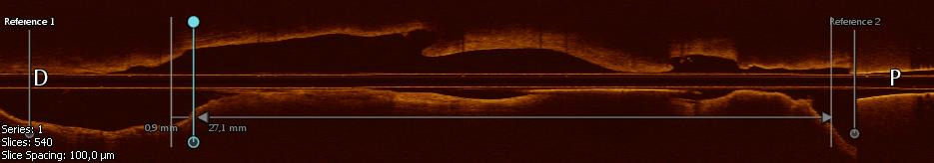
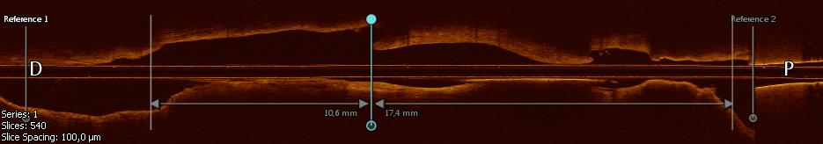
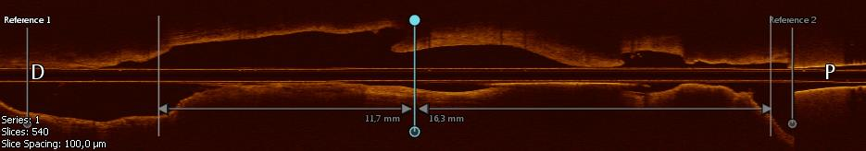
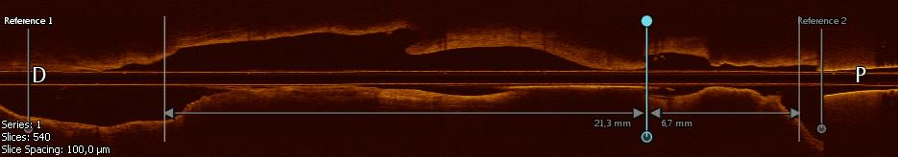

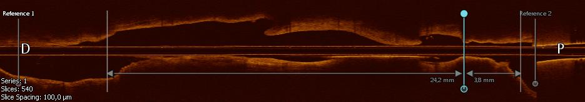
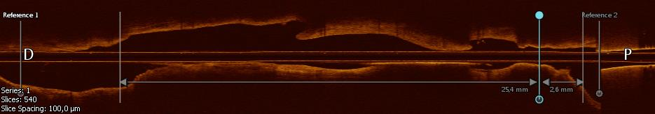
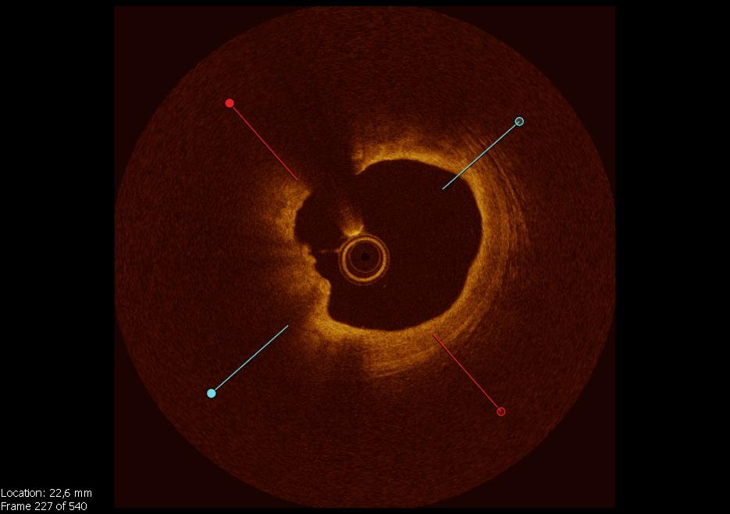
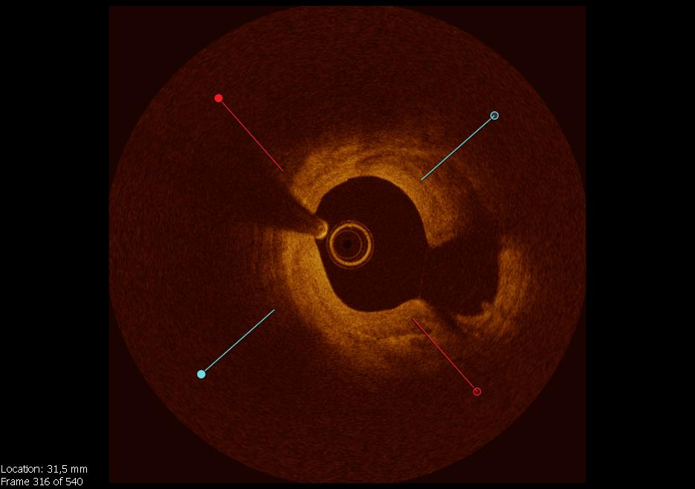
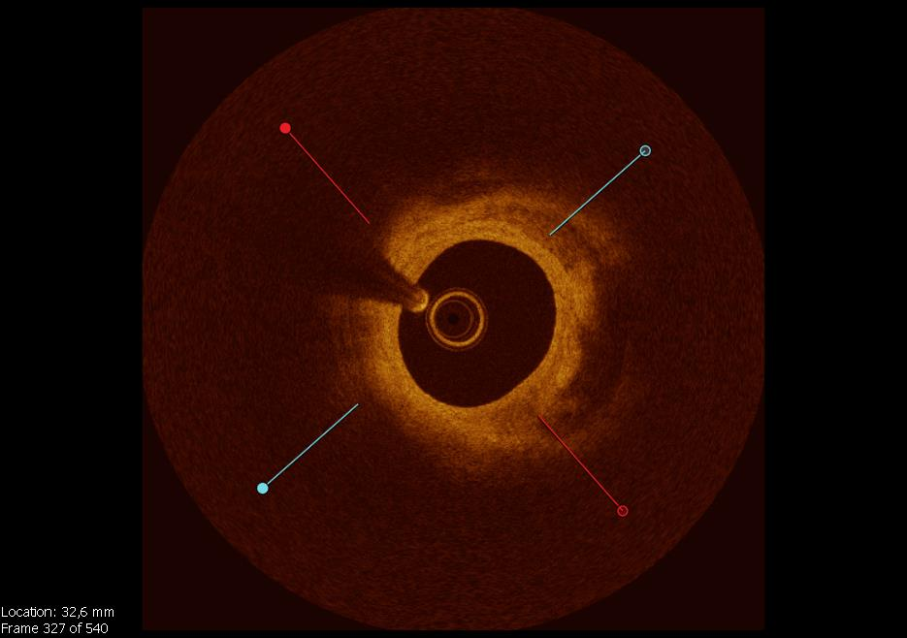
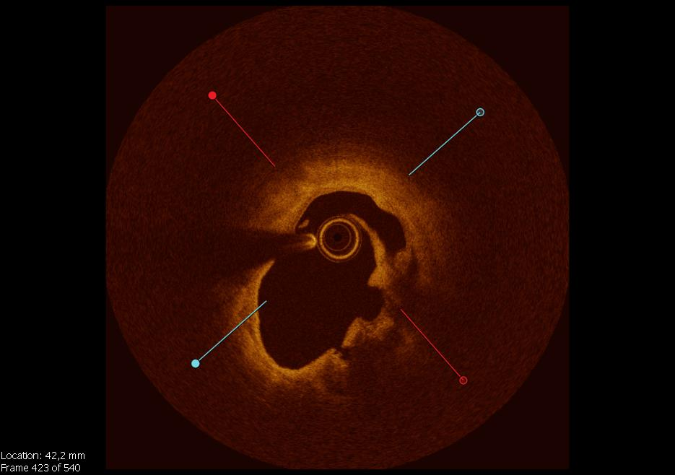
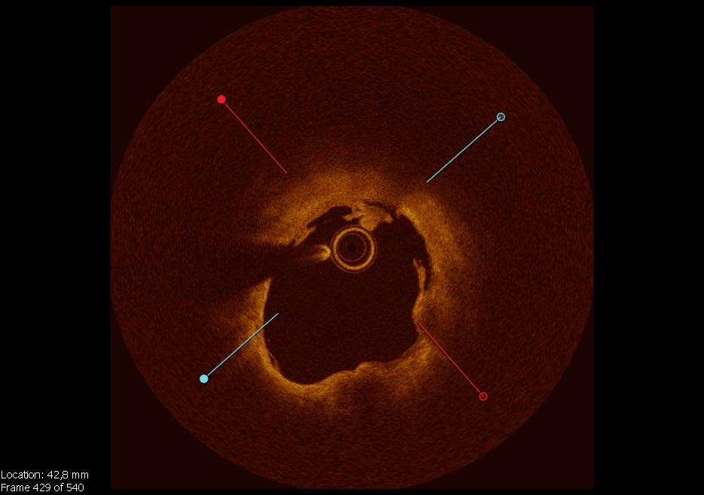
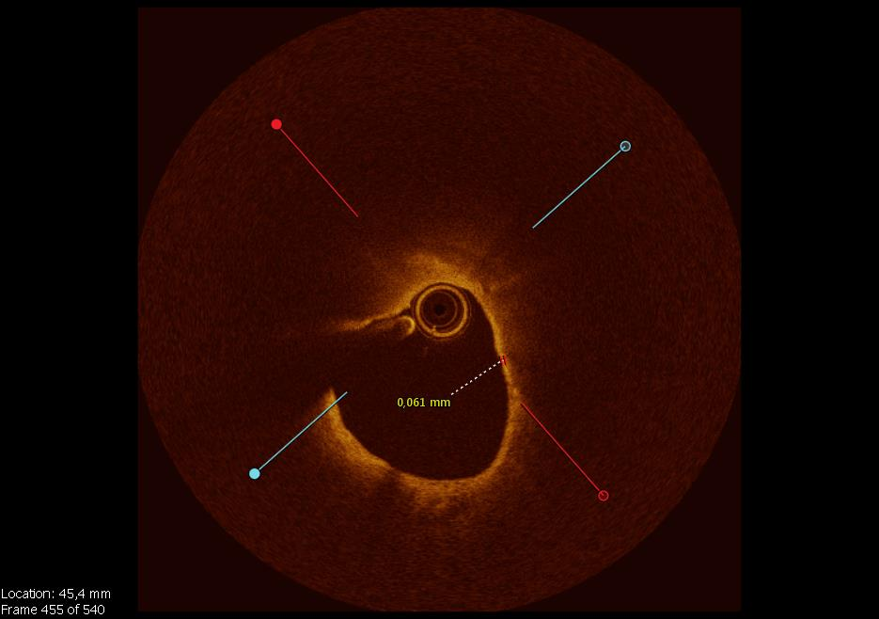
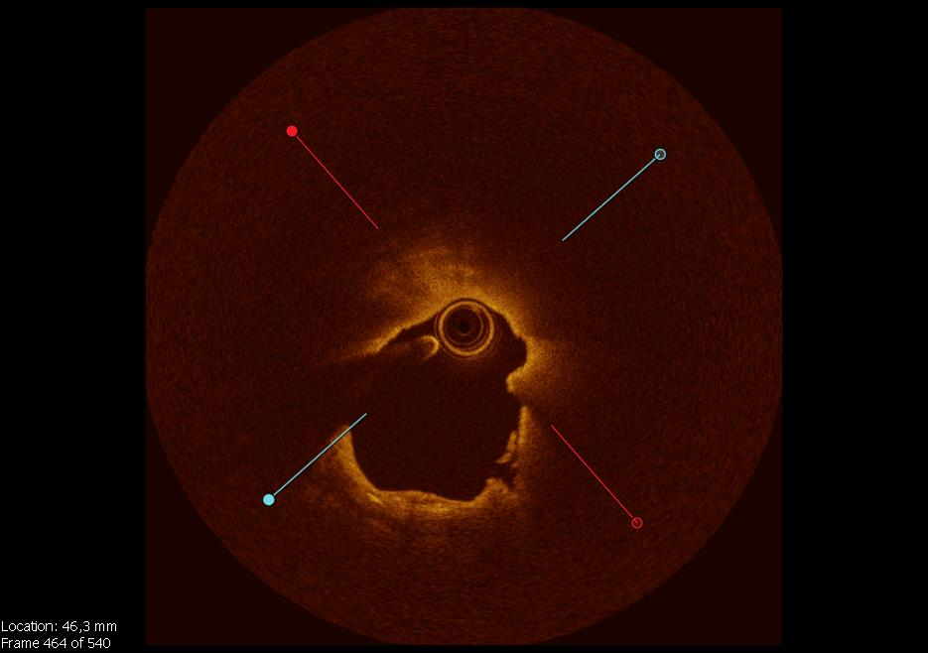
Coexistence of complicated plaques in same lesion
Calcification with thrombus
Old plaque rupture
Healed plaque
Old plaque rupture
Thrombus
TCFA
Plaque rupture
Plaque progression in DM:
Longitudinal vessel assessment may demonstrate coexistence of multiple plaque morphologies eg. superficial calcification with thrombus, healed plaque, plaque rupture, lipidic plaque with TCFA
COMBINE

Slide 19
Primary Endpoint
(CD, TVMI, CD-TLR, or Hospitalization UAP)
25%
HR 4.7 95%CI (2.0-10.9) p = 0.0004
TCFA
No TCFA
20%
Log-rank test p <0.0001
13.3%
15%
Cumulative Incidence %
10%
5%
3.1%
0%
30
182
365
546
Nr. at Risk
Days since enrollment
Nr. at Risk
TCFA
98 88 86 44
292 286 281 144
No TCFA

Slide 20
Primary Endpoint Composites
Log rank p = <0.0001
Log rank p < 0.001
Log rank p = 0.002
Cumulative Incidence %
Log rank p = 0.57
COMBINE

Slide 21
Secondary Endpoint
HR 1.25 95%CI (0.28-5.59) p = 0.77
TCFA
25%
FFR (+) Revascularization
Log-rank test p = 0.42
20%
Cumulative incidence %
13.3%
15%
10%
9.7%
5%
0%
0%
30
182
365
546
Nr. at Risk
Days since enrollment
TCFA
98 88 86 44
93 87 84 47
FFR + Revascularization

Slide 22
Secondary Endpoint: Composites
Log rank p = 0.01
Log rank p = 0.55
Cumulative Incidence %
Log rank p = 0.77
Log rank p = 0.31
COMBINE

Slide 23
Multivariable COX Regression Analyses
Multivariable Cox Regression | HR | 95% CI |  | p value
Group (TCFA) | 4.60 | 1.95 - | 10.96 | <0.001
Age | 0.99 | 0.95 - | 1.03 | 0.66
MI at presentation | 2.48 | 0.94 - | 6.53 | 0.07
Previous PCI | 2.21 | 0.94 - | 5.21 | 0.07
MLA (decrease 1mm²) | 1.57 | 1.02 - | 2.41 | 0.04
Insulin treated DM was not significant in univariable regression analysis and was not included in multivariable analysis
COMBINE

Slide 24
Study Limitations
The results of this study cannot be generalized to all patients with FFR(-) lesions; however, DM patients represent > 1/3 of the patients undergoing coronary angiography
Baseline differences, arising from the non-randomized nature of the study, might persist despite statistical adjustment
The study was underpowered to detect differences in low incidence endpoints such as cardiac mortality
The study was not sufficiently powered for the secondary endpoint at 18 months; however, longer follow up may reveal new insights
COMBINE

Slide 25
Conclusions
COMBINE showed for the first time that in DM patients
  Prevalence: More than 25% of all FFR (-) lesions represent high-risk plaques (OCT-assessed TCFA)
  Impact: Presence of a high-risk plaque (TCFA) is a strong predictor of future MACE, despite lack of ischemia
  Amplitude: Patients with high-risk plaques (TCFAs) have a significant (HR 4.7) increase in target-lesion related MACE (and MI) as compared to patients without TCFA, already at 18 months
  New insights: Ischemia and future adverse events represent, to a large extent, two separate concepts
COMBINED FFR & OCT can improve the accuracy of high-risk lesion/ patient identification and should therefore be embraced
COMBINE

